Slide 1
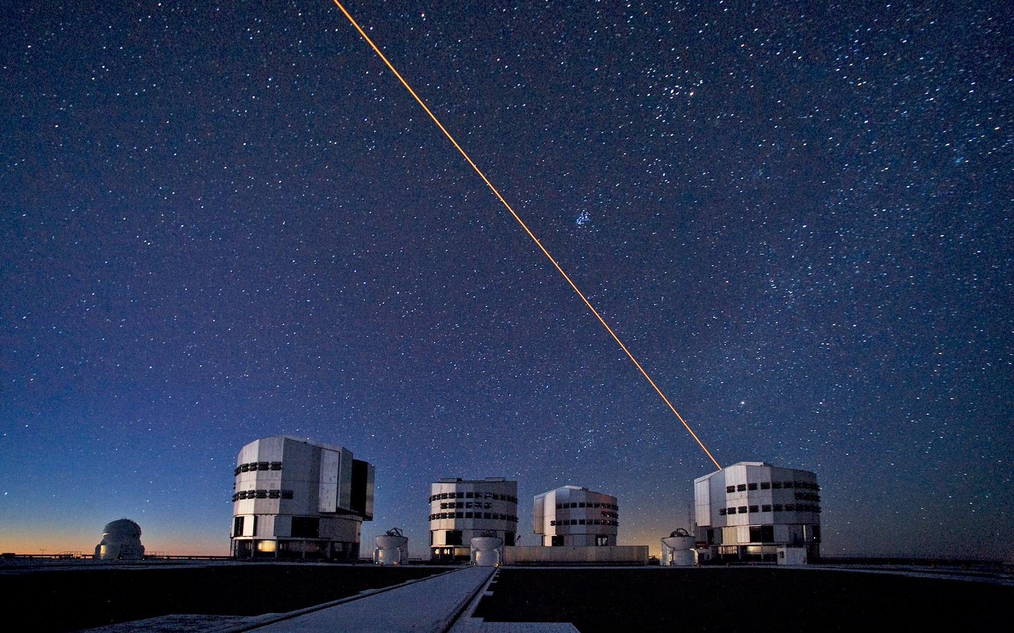






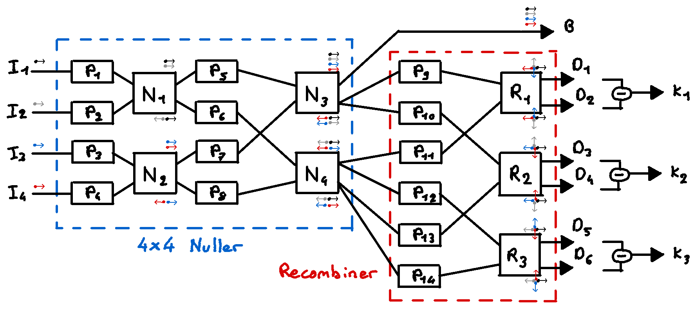
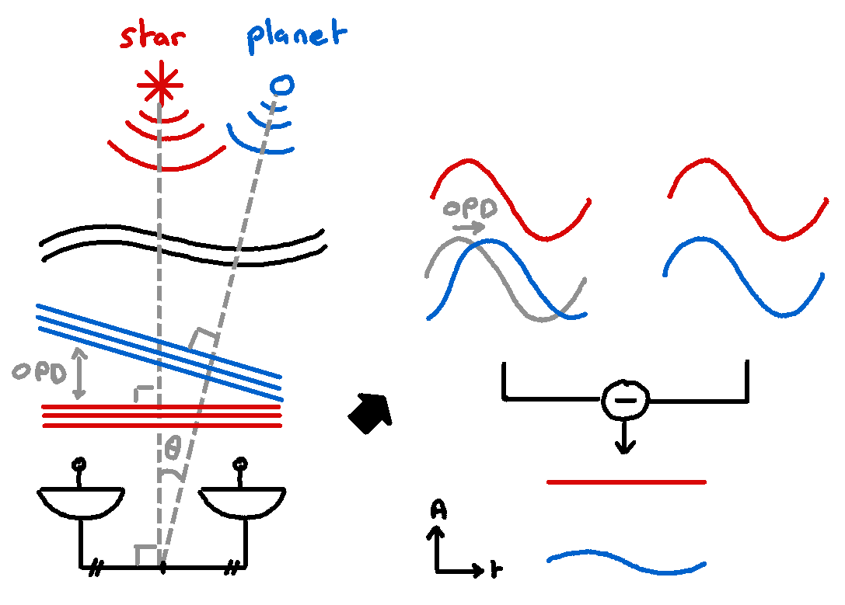
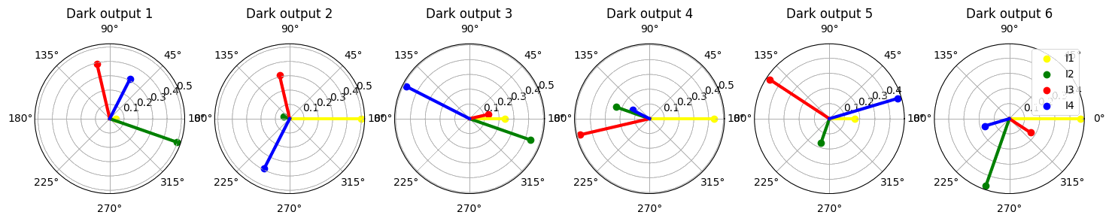
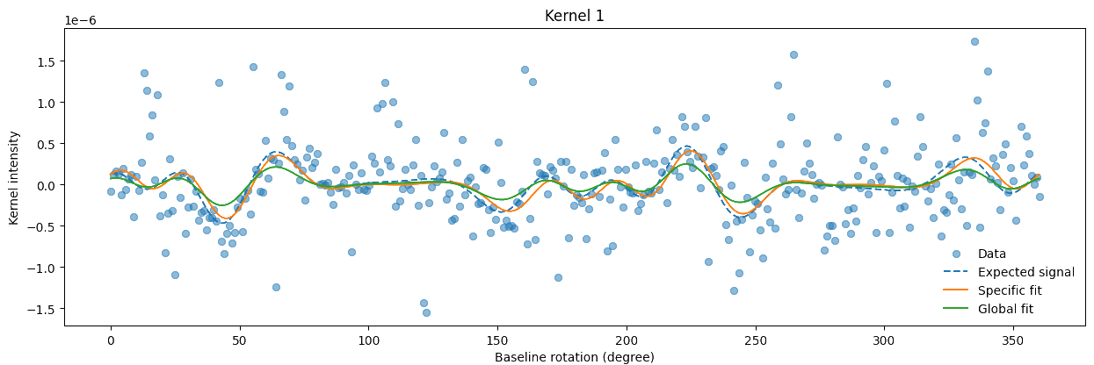
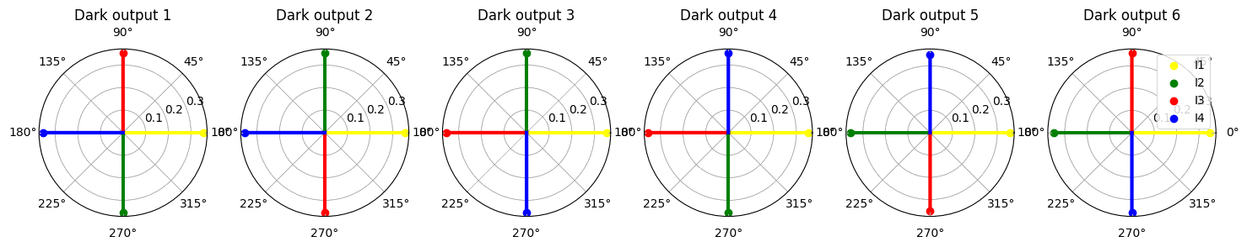
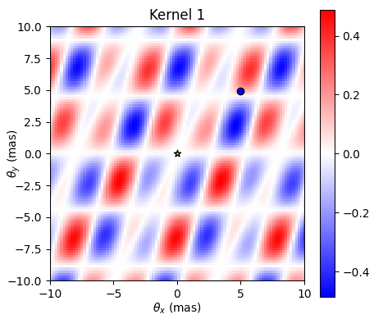
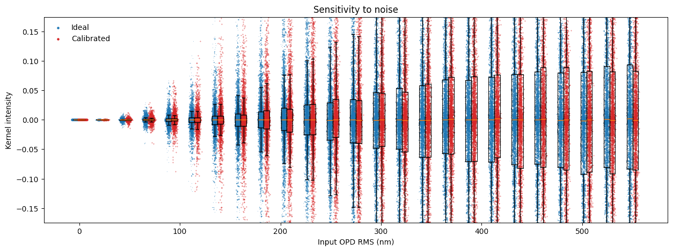
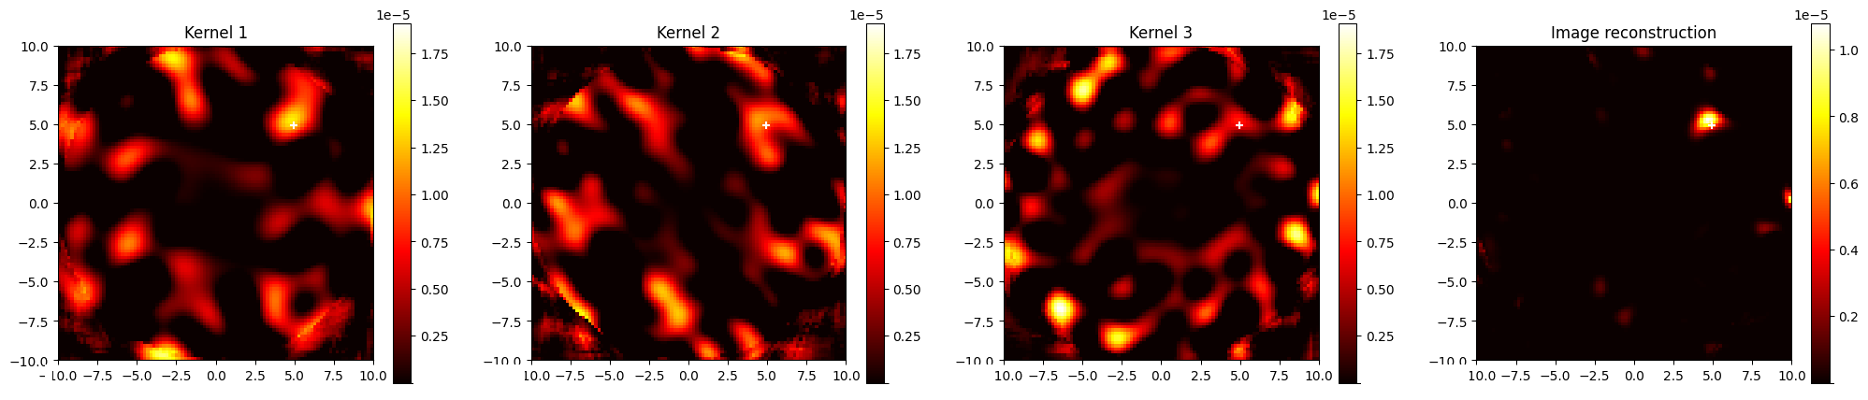
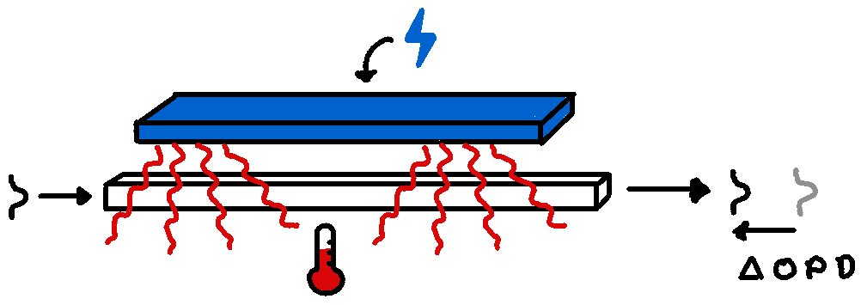
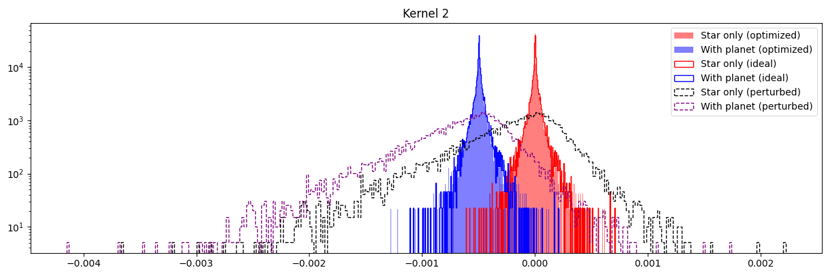
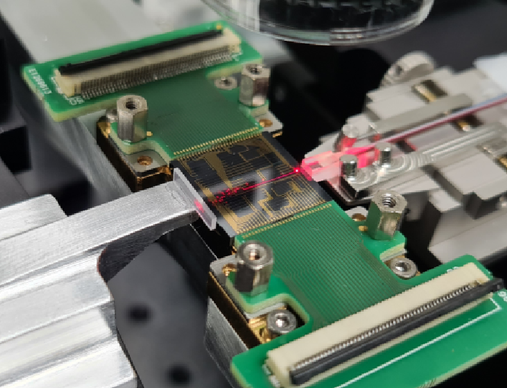
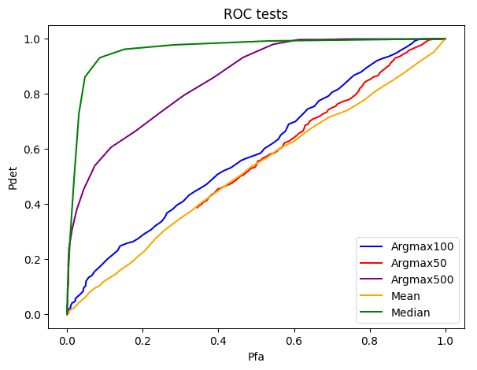
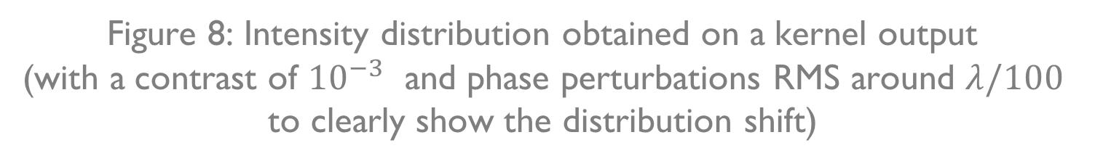
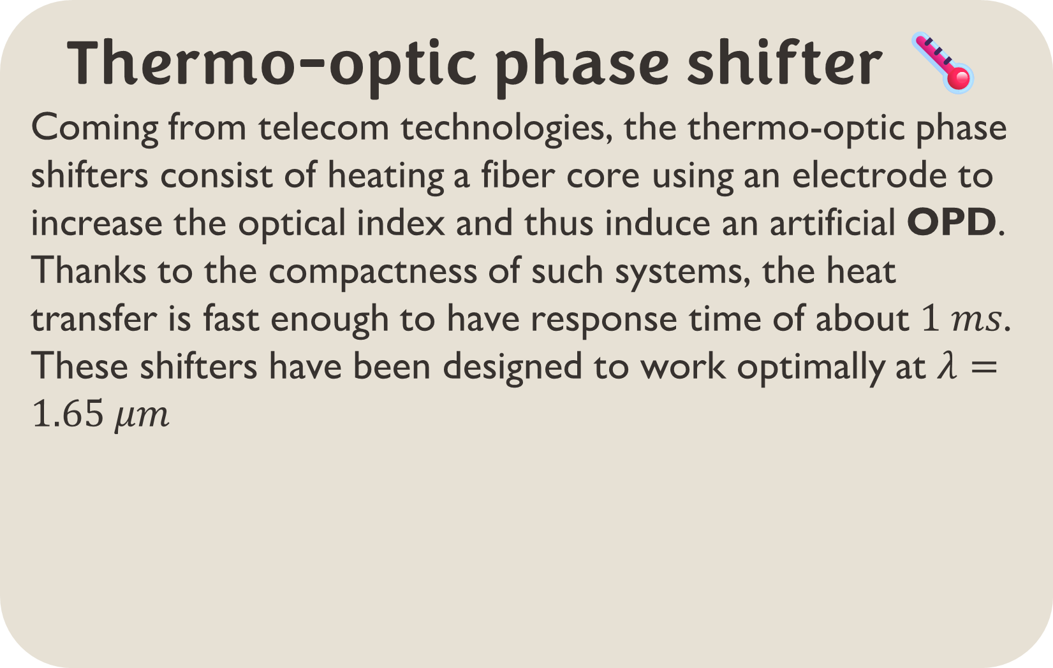


DIRECT DETECTION OF EXOPLANETS USING TUNABLE KERNEL-NULLING Vincent Foriel^{1,*}, Frantz Martinache¹, David Mary¹ ¹ Université Côte d'Azur, Observatoire de la Côte d'Azur, CNRS, Laboratoire Lagrange, France * vincent.foriel@oca.eu
In a nutshell 🥜
This poster presents a thesis that aims to enhance nulling interferometry for exoplanet detection using a four-telescope architecture named Kernel-Nuller. By integrating 14 active phase shifters, we aim to mitigate phase aberrations caused by manufacturing defects. A first objective is to develop a technique that allows to find the best shifts to inject to optimize the component performance. A second step consists of analyzing intensity distributions produced and applying statistical tests and machine learning to extract valuable information. This poster presents the preliminary results.
Nulling interferometry 〰️ On the VLTI
This technique consists in taking advantage of the angular separation and the coherence properties of the light to destroy the star light without destroying the one coming from the planet. Our approach
enhances this principle by
introducing « Kernels »
which combine the light
from 3 telescopes ^{[1]} or
more to be less sensitive to
low order phase aberrations
and asymmetries ^{[2]} the output to better constrain the planet position.
Calibration algorithm 🗜️
To find the best phase shifts to introduce, I proposed an algorithm inspired by dichotomy and gradient descent that accepts or rejects steps in the parameter space according to the bright $M_{1}$ and dark asymmetry $M_{2}$ metrics. $B$ and $D$ are respectively the bright and darks output intensities (Fig. 1).
$$M_{1}=B$$
$$M_{2}=\left|D_{1}−D_{2}\right|+\left|D_{3}−D_{4}\right|+\left|D_{5}−D_{6}\right|$$
Figure 1: Scheme of our Kernel-Nulling architecture
Parallactic diversity 🔄️
Taking advantage of the Earth’s rotation, the kernel distribution will shift according to a known modulation (Fig. 3). For each kernel output, one fits this modulation to the data points, giving the position and contrast of the potential object. By averaging all these parameters and computing a global fit, we can then see if this latter is well correlated with each kernel modulation.
Figure 2: Concept of nulling. The signals are placed in phase opposition to destroy the on-axis source and let the light from nearby objects
Figure 3: Transmission map of one of the Kernels obtained using the 4 telescopes of the VLTI. The transmission zones and blind bands are directly derived from the telescopes’ positions. By rotating the baseline, we can get a modulated signal from which we can precisely constrain the planet position. (cf. “Parallactic diversity” block)
Figure 6: Phase and amplitude of the 4 input signals on the 6 dark outputs before (top) and after (bottom) the calibration process
Figure 9: Kernel modulation & fitting
On-sky contribution 🌌
By weighting the kernel transmission map by the output intensity and integrating it over the parallactic angle, we can create a map of the source of input light. By combining the 3 maps, one can constrain precisely which part of the sky contributed the most to the data we have. Thus, this process reveals the approximative object location, spread by the input phase aberrations.
Distribution analysis 📊
In the presence of unavoidable input phase aberrations, the system is not able to perfectly cancel the star light. By performing many observations, we obtain some intensity distribution intensity at the kernels’ output.
The presence of an exoplanet in the field of view results in a shift of the distribution. The brighter the planet, the more pronounced the shift will be. When one increases the contrast, both distributions quickly become hard to distinguish. We then study different statistical (Fig. 11) tests to determine the one offering the best detection reliability.
Thermo-optic phase shifter 🌡️
Coming from telecom technologies, the thermo-optic phase shifters consist of heating a fiber core using an electrode to increase the optical index and thus induce an artificial OPD. Thanks to the compactness of such systems, the heat transfer is fast enough to have response time of about $1 ms$. These shifters have been designed to work optimally at $λ=1.65 μm$
Figure 10: Repartition of on-sky contributions and cumulation of these maps to reveal the object location.
Figure 7: Evolution of kernel distribution spread in relation to the input phase aberrations.
Discussions & prospects 💬
These promising results are mitigated by the persistent sensitivity to high order phase aberration. A contrast of ${10}^{−6}$ requires an AO correction that brings phase aberrations below $λ/100$ RMS. Also, the prospects will consist of deeply investigating which is the best test statistic (and consider new ones), making these simulations chromatic and confirming these results on a test bed.
Figure 4: Scheme of thermo-optic phase shifter
Active optical components 💡
The idea of our architecture is to combine the nulling interferometry with the phase shifter technology to make an active optical component that can be calibrated to compensate the phase aberration induced by manufacturing defects.
Figure 11: ROC test to compare the detection performance of different test statistics according to the probability of false alarm of these tests. Among the tests performed here, considering the median of the distributions appear to be the most efficient way to reject the null hypothesis (star without planet).
Figure 5: Picture of the wafer that contains several prototype architectures of Kernel-Nuller. The overall component size is comparable to a 1 cent coin.
Figure 8: Intensity distribution obtained on a kernel output
(with a contrast of ${10}^{−3}$ and phase perturbations RMS around $λ/100$ to clearly show the distribution shift)
References 📜
Cvetojevic, N. et al. “3-beam self-calibrated Kernel nulling photonic interferometer” (2022). Preprint at http://arxiv.org/abs/2206.04977.
Martinache, Frantz, et Michael J. Ireland. ”Kernel-Nulling for a Robust Direct Interferometric Detection of Extrasolar Planets”. Astronomy & Astrophysics 619 (2018): A87. https://doi.org/10.1051/0004-6361/201832847.
Acknowledgment 🤝
Thanks to Romain Laugier for his wise advice, to Nick Cvetojevic for his introduction to the topic of photonics and to Margaux Abello for her presentation recommendations. This thesis is made possible by the PHOTONICS project of the PEPR ORIGINS and Thales Alenia Space
Glossary 📖
AO: Adaptative Optics
OPD: Optical Path Difference
RMS: Root Mean Square ROC: Receiver operating characteristic
VLTI: Very Large Telescope Interferometer

